Slide 1
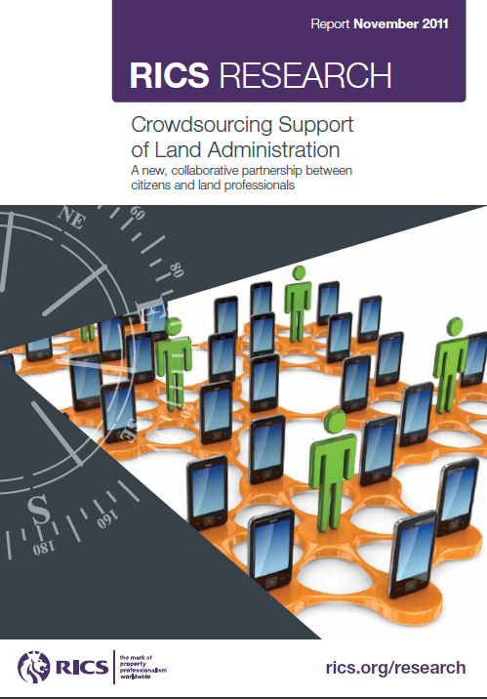
Robin McLaren
Know Edge Ltd, Edinburgh
robin.mclaren@KnowEdge.com
Second UN-SPIDER Expert Meeting
Geneva, 16th November 2011
Report available from:
www.rics.org/land

Slide 2
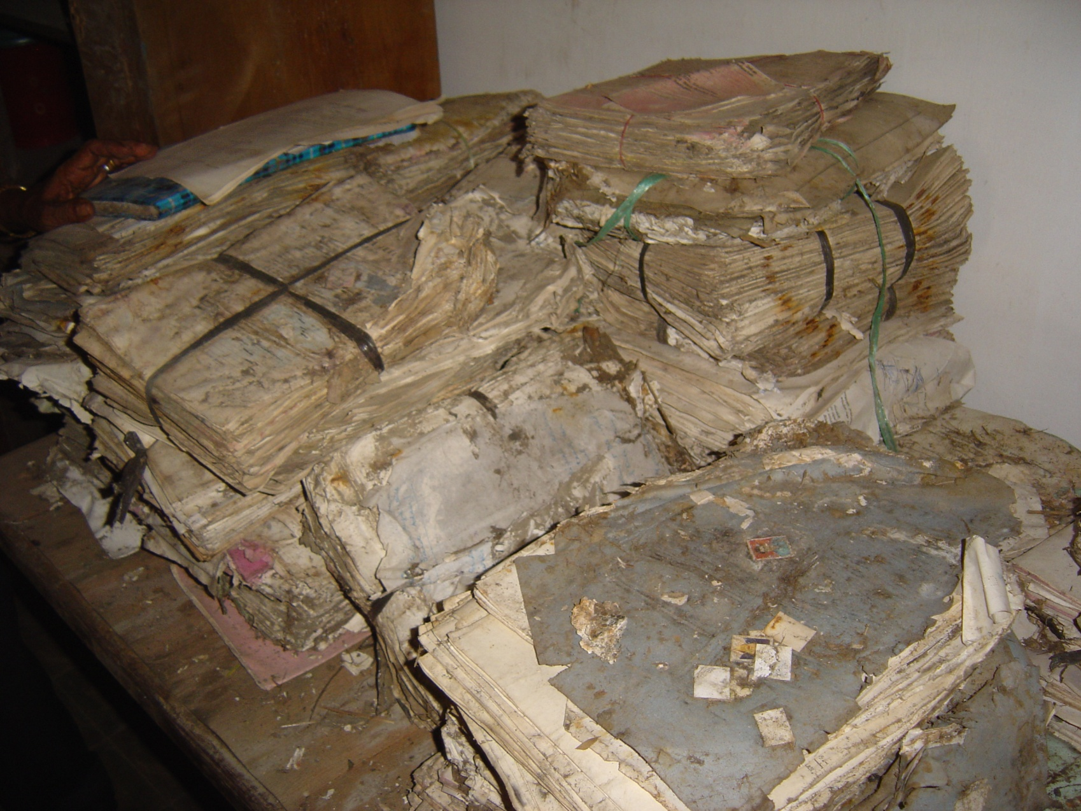
Land and Vulnerability to Disaster
Land Use and Planning: Settlements on hazardous or environmentally sensitive land.
Land Tenure: “Renters and squatters”. Informal urban settlements. Lack of recognition of customary rights.
Land Administration: Incomplete or inaccurate records; no backups. Lack of national/local coordination. Corruption.
Land Administration: Incomplete or inaccurate records; no backups. Lack of national/local coordination. Corruption.
Land Disputes: History of displacement and conflict. Slow or dysfunctional Courts.
Land Law: Widows and orphans’ rights. Access to land for resettlement.
Aceh Records Damage

Slide 3
Challenge to Land Administrators
Land Administration Solutions are only fully operational and work reasonably well in about 30 - 50 and mainly OECD countries and countries in transition in central Asia.
Only 25% of the 6 billion land parcels worldwide are formally registered and have robust security of tenure.
Not enough current (350,000) or planned Land Professionals to support current Land Administration System paradigm

Slide 4
The Perfect Storm of Change
Urbanisation
Security of Tenure Chasm
Too Few Land Professionals
Global Navigation Satellite Systems
Image Based Mapping
Mobile Phones
Web 2.0 Social Networking
Crowdsourcing
Spatially Enabled Society
Can crowdsourcing support a partnership between Land Professionals and Citizens?
Source: http://pixdaus.com

Slide 5
Empowering Citizens to Engage with Land Administration
Potential Mobile Land Administration Services
Accessing Customer Information Services
Recording Ownership Rights
Obtaining Title
Accessing Land Information
Paying Mortgage Instalments
Participating in Development Control / Planning

Slide 6
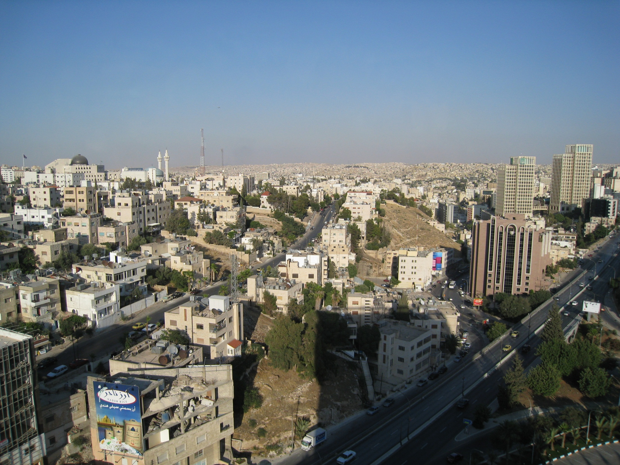
Greater security of tenure and more complete & resilient land records.
Citizens understand land rights issues and can participate in restitution process.
Know where to place homeless people.
Land administration less vulnerable to disasters.
Let’s try it and pilot it and make land administration by the people for the people a distinctly 21st Century phenomenon.
Know Edge Ltd
6

