Slide 1
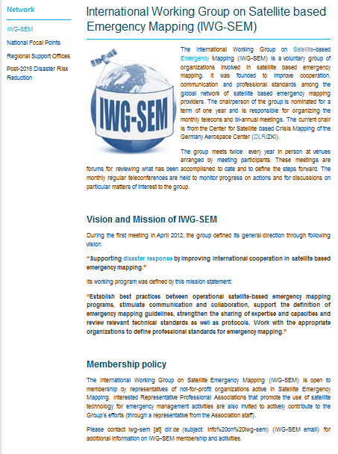
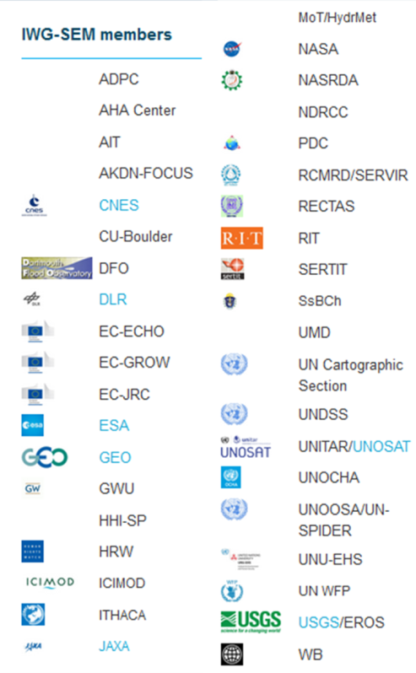
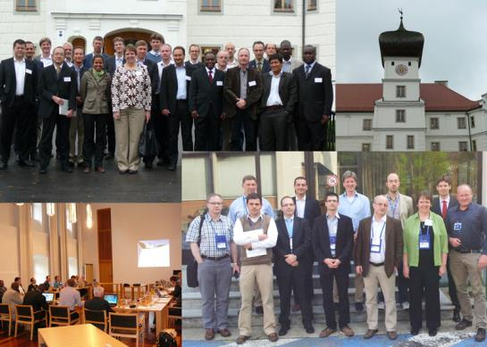
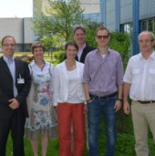


International Working Group on Satellite based emergency Mapping – IWG-SEM
Harmonisation
Cooperation
Guidelines
Open to new partners
Monthly Telcos
Biannual Meetings
www.iwg-sem.org

Slide 2
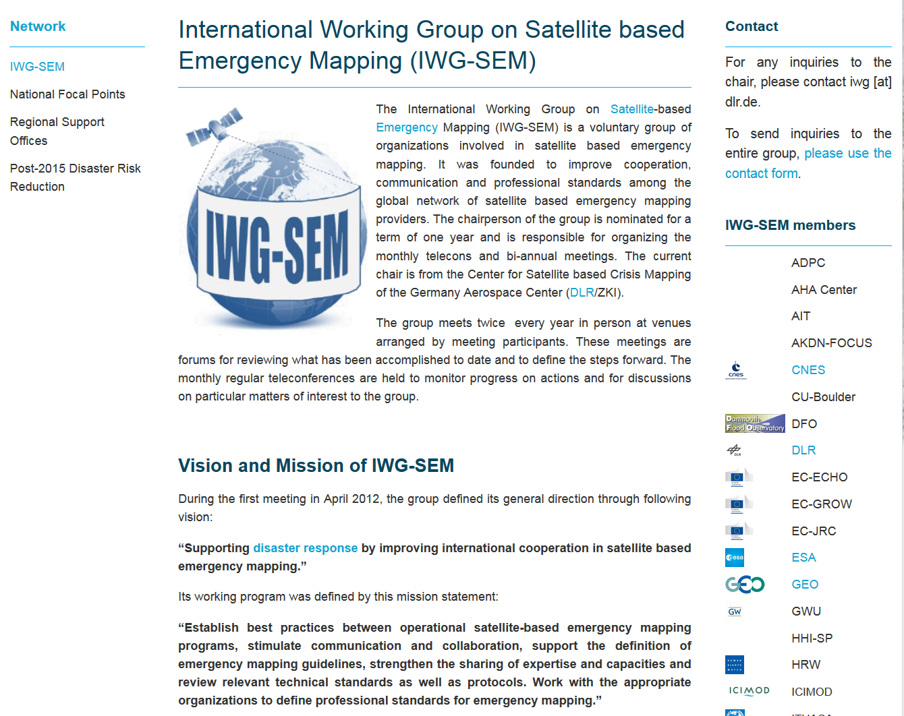
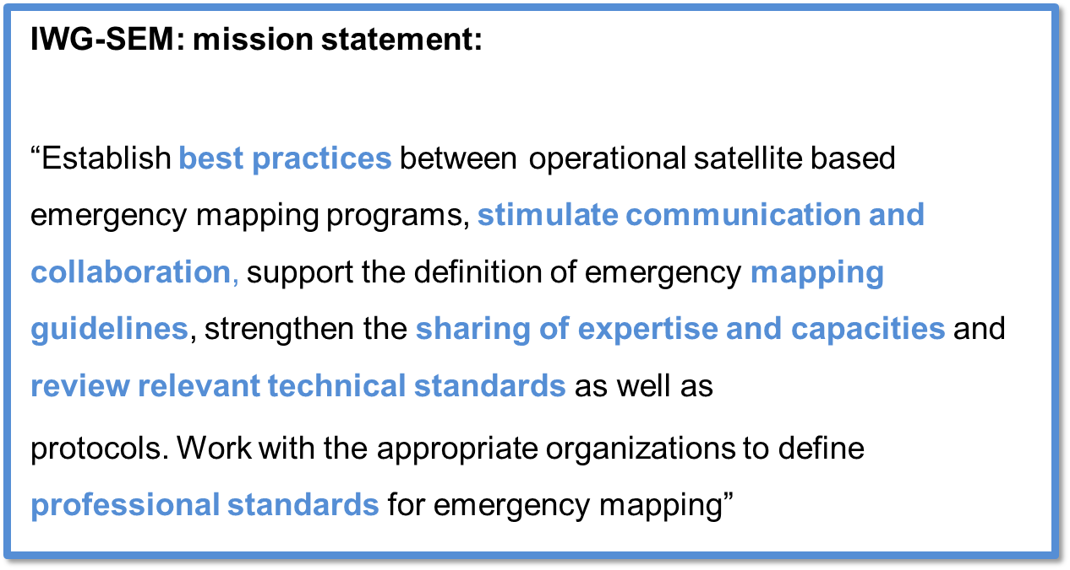
IWG-SEM: mission statement:
“Establish best practices between operational satellite based emergency mapping programs, stimulate communication and collaboration, support the definition of emergency mapping guidelines, strengthen the sharing of expertise and capacities and review relevant technical standards as well as
protocols. Work with the appropriate organizations to define professional standards for emergency mapping”

Slide 3
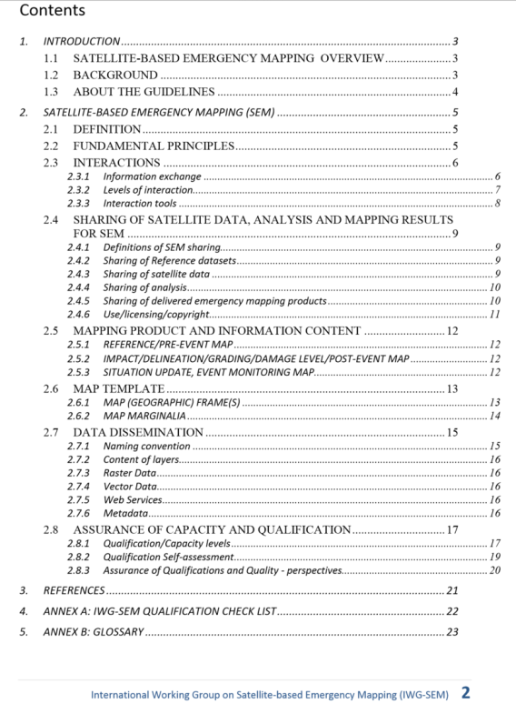
Emergency Mapping Guidelines
Define fundamental principles
Establish a procedure for interactions and sharing of data, analysis and mapping results
Organize mapping products, templates and dissemination policies
Anticipate problems of uncertainty in communication
Commit to assurance of capacity and qualification
Prepare a glossary for
emergency mapping vocabulary
1.0 => 2.0

Slide 4
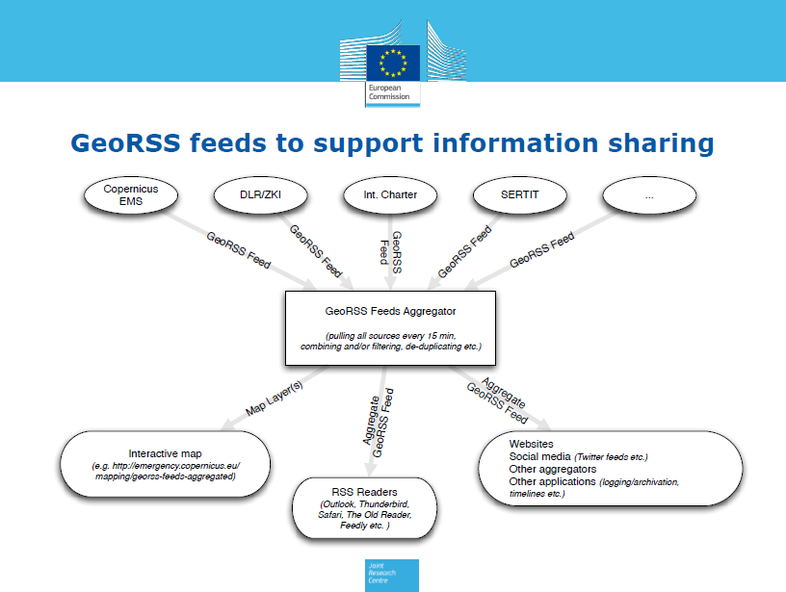
Info via GeoRSS when mapping activities start!
Source: EC/JRC

Slide 5
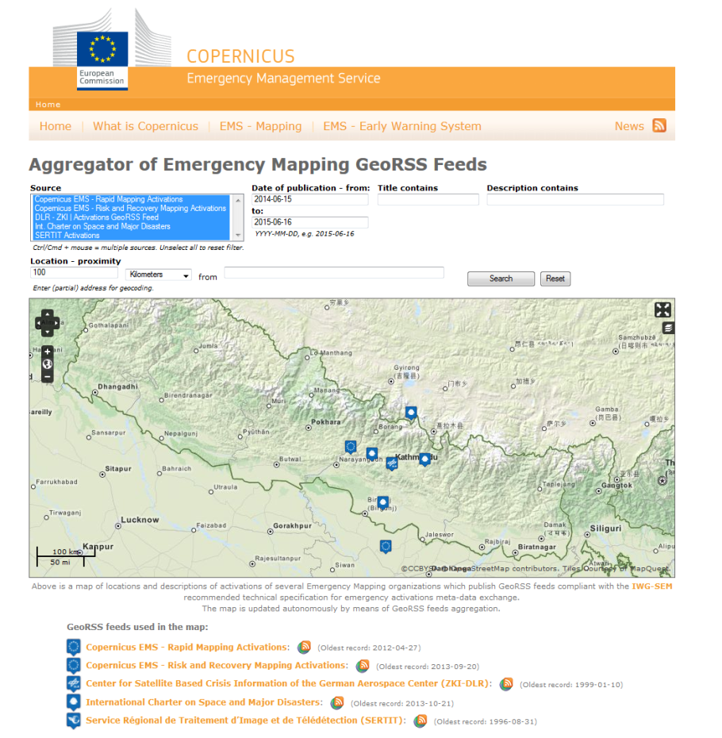
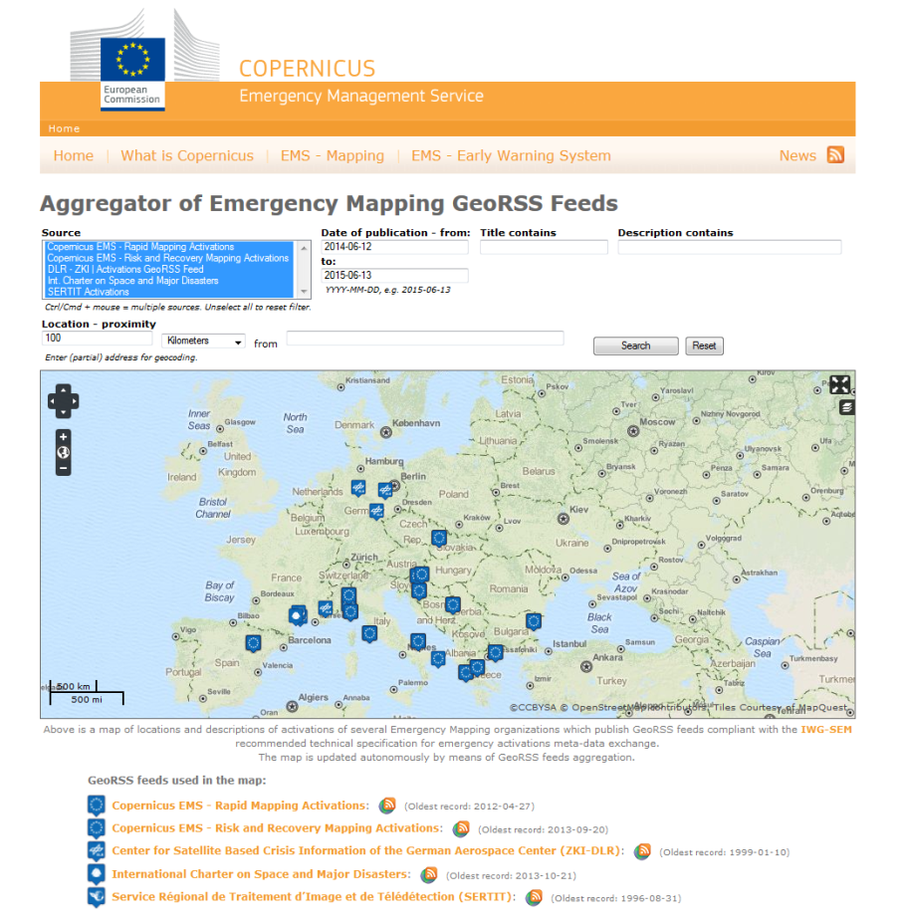
Aggregator to visualize SEM activities and need for coordination/cooperation
Source: EC/JRC

Slide 6
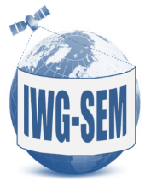
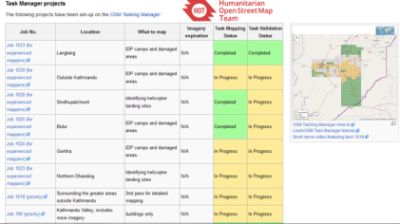
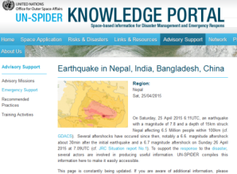
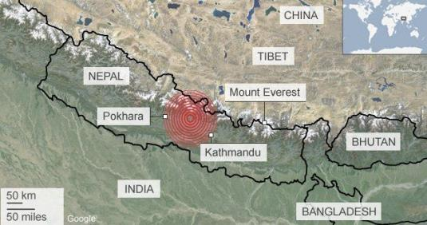
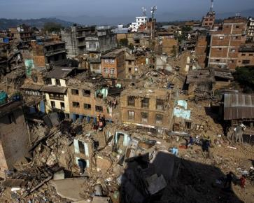

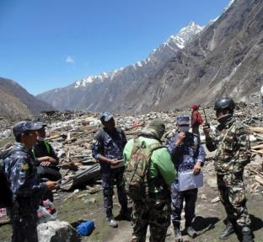
Ad-hoc cooperation Nepal: April/May 2015
Initial information e-mails among the group members only hours after the earthquake
Mutual information about major international activities via dedicated IWG-SEM emergency mailing list and three major international telecons with global participation.
UN-SPIDER gathering relevant information on satellite response on dedicated web page
Coordination with OSM - ideas for in-depth cooperation in future
Preparation of a dedicated lessons learnt session at the Spring Meeting (End of May)
Sources: BBC, Reuters, Getty Images, Reuters

Slide 7
Cooperation in ad-hoc situations – ideal world
Inform each other about beginning SEM activations
Harmonize information about user requirements
Inform each other about AOIs and type of analysis being done
Adjust, share, exchange AOIs and analysis results to the extent possible
Use redundancy for cross-checking, validation, quality assurance
Avoid duplication or contradiction of information
Ensure best use of mapping capacities available
Help global steering of satellite tasking and data acquisition
Fuse information derived from SEM to be available for users on the ground

